Slide 1
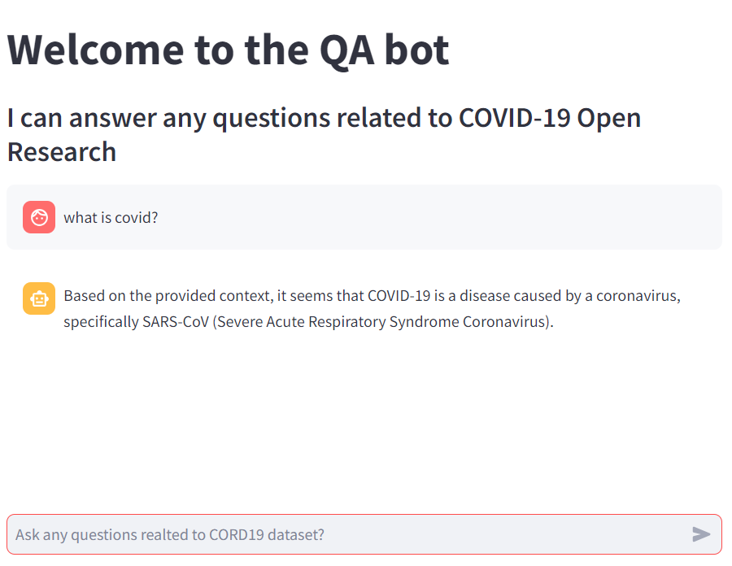

Slide 2
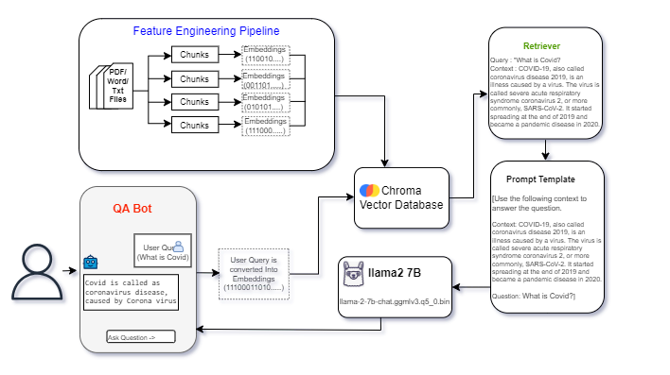
Architecture

Slide 3
Evaluation Metrics
Accuracy
92.85%

